Slide 1

Module 3
Advanced Multiple Linear Regression (MLR)
Notes:
Guidelines
Use section headers to chunk content in your presentation.
Use the same style of section header throughout your presentation.
Keep your title to no more than 2 lines.

Slide 2
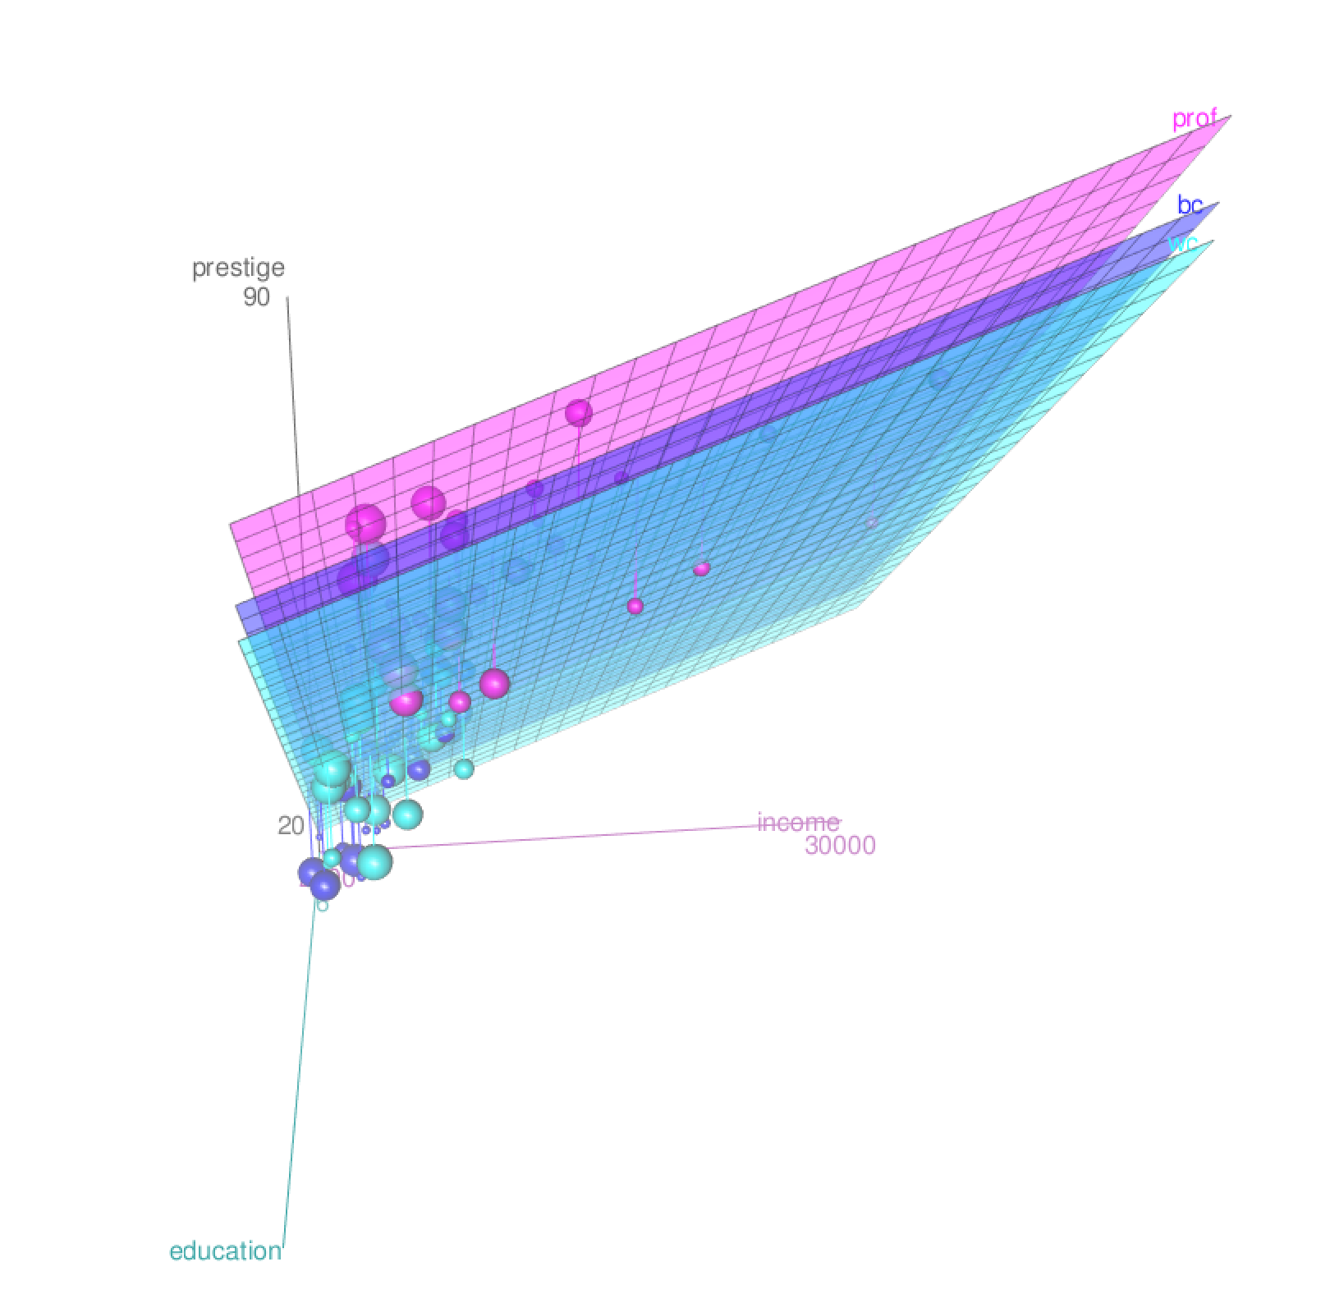
Interactions
Notes:
Guidelines
Use a title slide at the beginning of your presentation. There are 9 variations of title slides to choose from.
If you will have a series of slideshows, we recommend using the same style of title slide for each presentation.
Keep your title to no more than 2 lines.
Do not change the font style or font size of the title or subtitle.

Slide 3
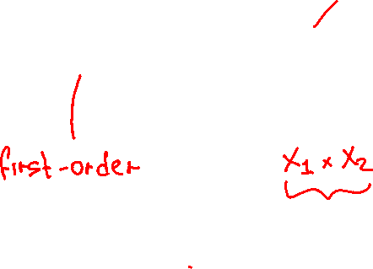
Interactions
The effect of 1 variable on the response depends on the level of another.
The model with an interaction term between x₁ and x₂:
y = β₀ + β₁x₁ + β₂x₂ + β₃x₁x₂ + ε
This is an Interaction Term
between x₁ and x₂

Slide 4





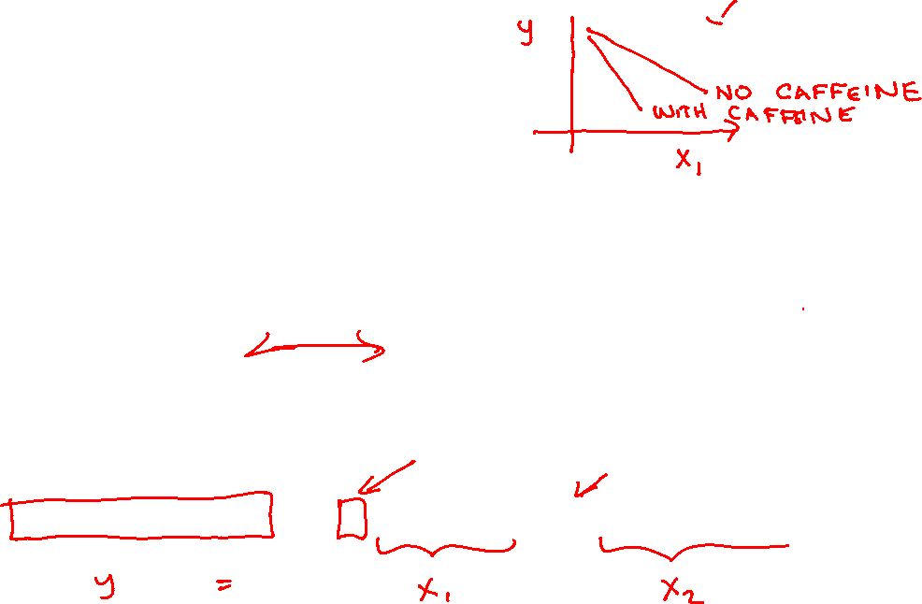
Interactions
Headache Pain Level = β₀ + β₁Amount Tylenol + β₂Amount of Caffeine + ε

Slide 5
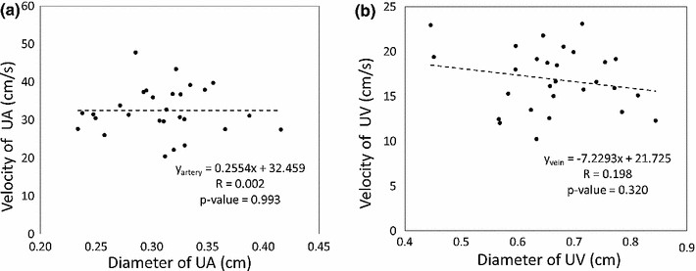
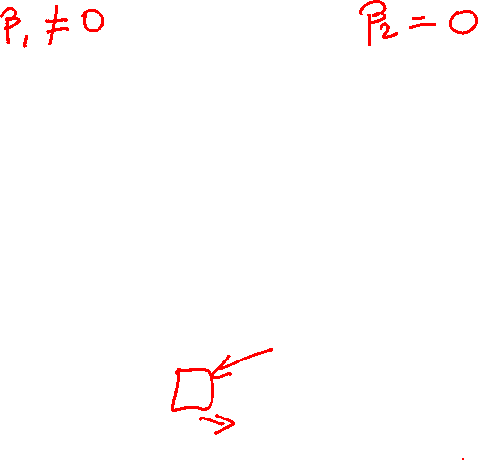


Effect of a Variable
What happens to $y$ when $x_{i}$ changes (slope)
Amount Tylenol
Amount of Caffeine
Headache Pain Level = β₀ + β₁Amount Tylenol + β₂Amount of Caffeine + ε

Slide 6
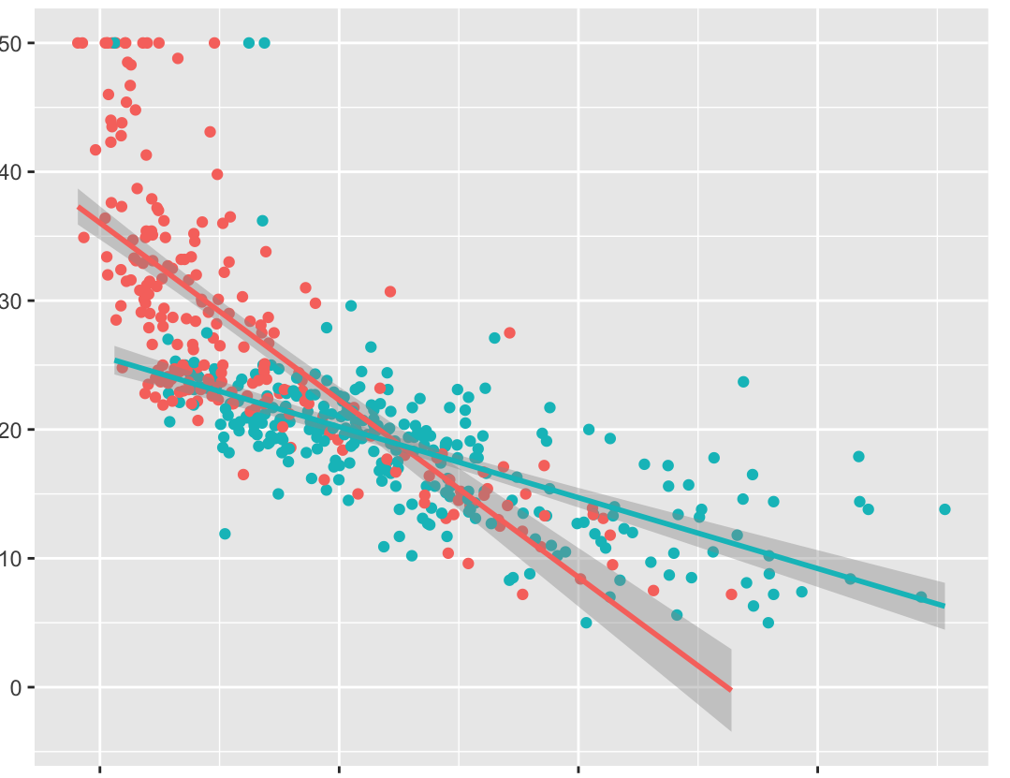
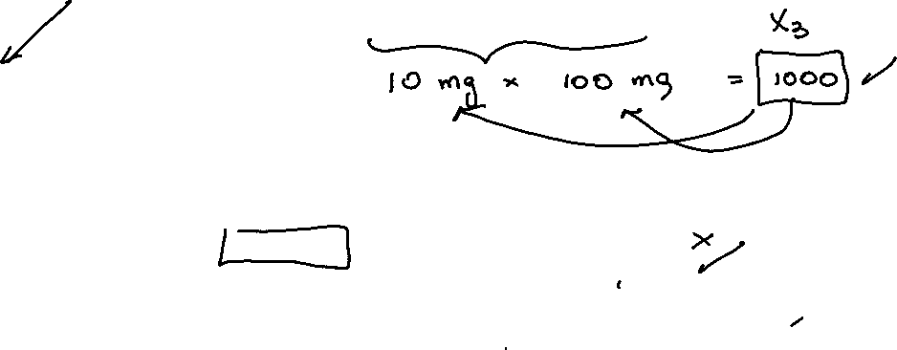
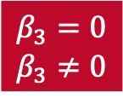
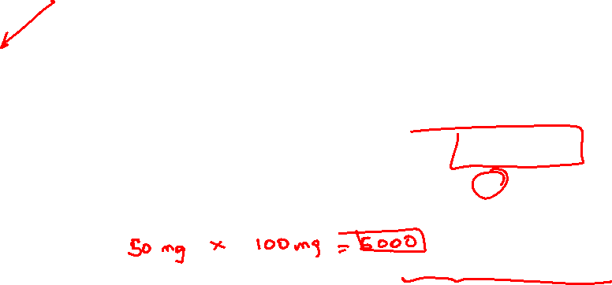
Interaction Effect
The effect of Tylenol on the pain depends on the level caffeine.
Interaction Term
Amount Tylenol*Amount of Caffeine
No Caffeine
Hypothesis Test
High Caffeine
$$β_{3}=0$$
$$β_{3}≠0$$
Headache Level = β₀ + β₁Amount Tylenol + β₂Amount of Caffeine + β₃Amount Tylenol*Amount of Caffeine + ε

Slide 7
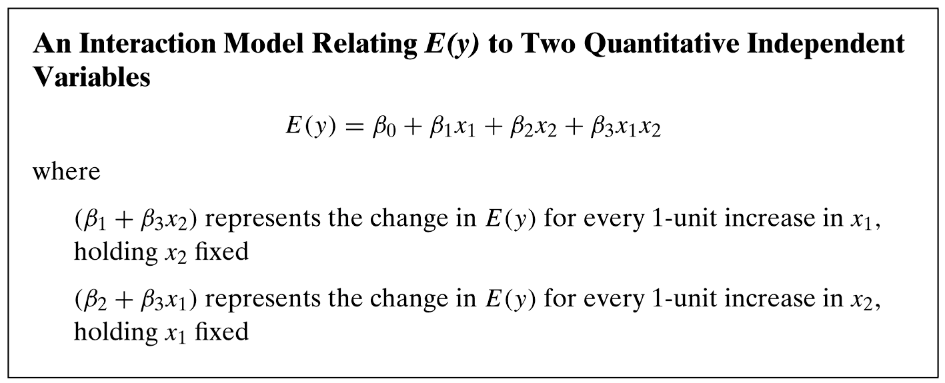
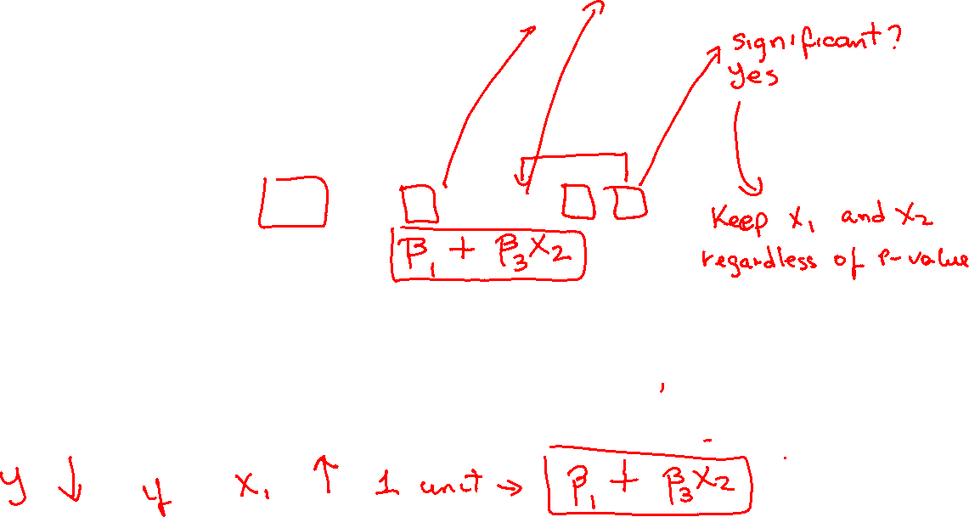
Interaction Effect

Slide 8
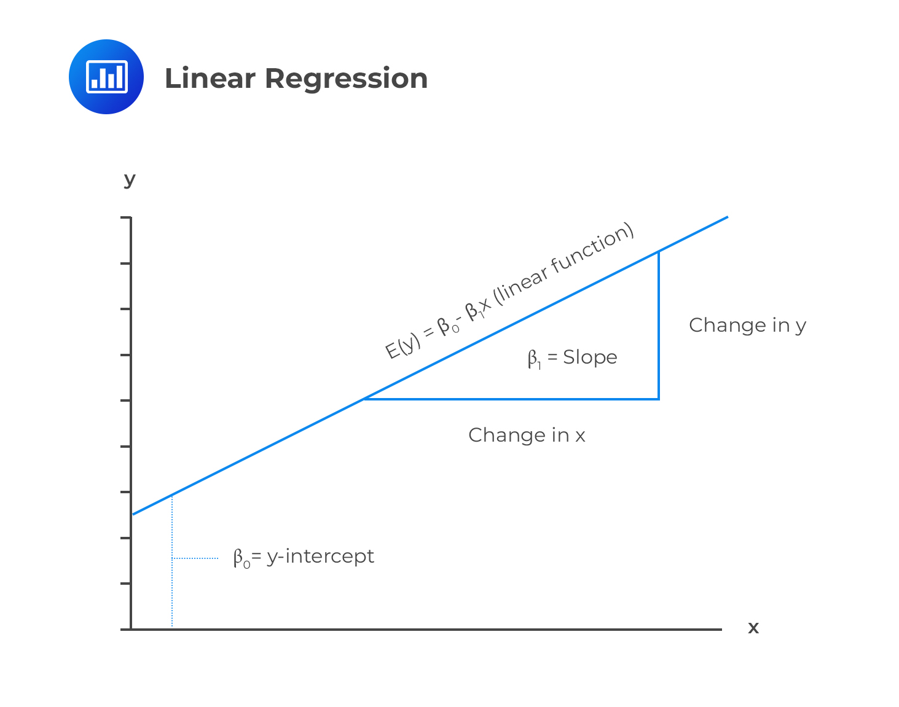
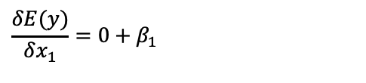
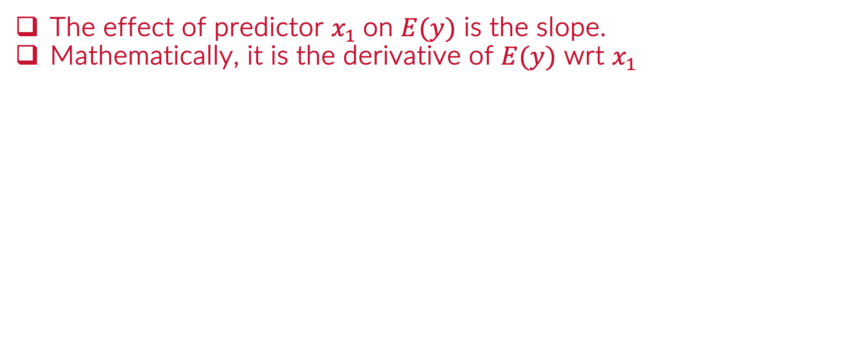
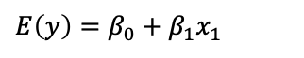
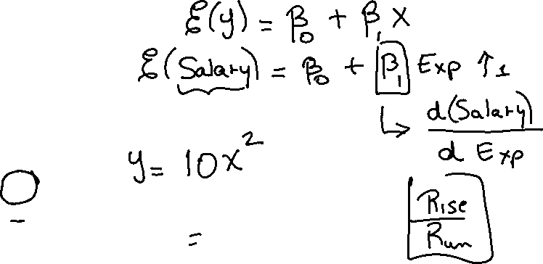
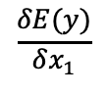
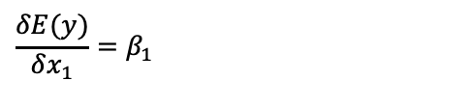
Interaction Effect
The effect of predictor $x_{1}$on $E(y)$ is the slope.
Mathematically, it is the derivative of $E(y)$ wrt $x_{1}$
Change in the expected value of y
$$\frac{δE(y)}{δx_{1}}$$
Produced by a change in the variable $x_{1}$
$$E\left(y\right)=β_{0}+β_{1}x_{1}$$
$$\frac{δE(y)}{δx_{1}}=0+β_{1}$$
$$\frac{δE(y)}{δx_{1}}=β_{1}$$

Slide 9

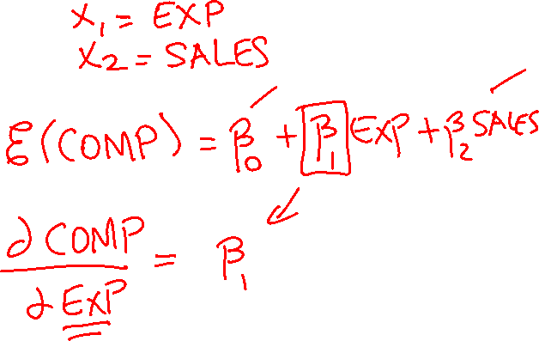
Example: CEO Compensation
Response: CEO Compensation
Predictor 1: Experience in years.
Predictor 2: Company Sales in MM

Slide 10
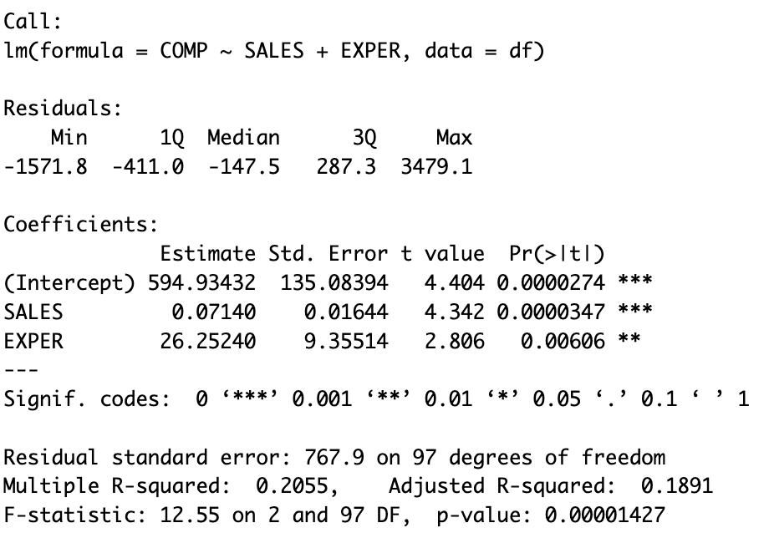
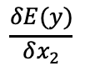
Effect of Experience
As Experiences increases by 1 year (change), COMP is expected to increase by $26,252 holding company sales constant.
Change in the expected value of COMP
$$\frac{δE(y)}{δx_{2}}$$
Produced by a change in the variable EXPER

Slide 11
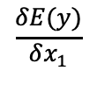

Effect of SALES
As company sales increases by $1M (change), COMP is expected to increase by $71 holding company sales constant.
Change in the expected value of COMP
$$\frac{δE(y)}{δx_{1}}$$
Produced by a change in the variable SALES

Slide 12
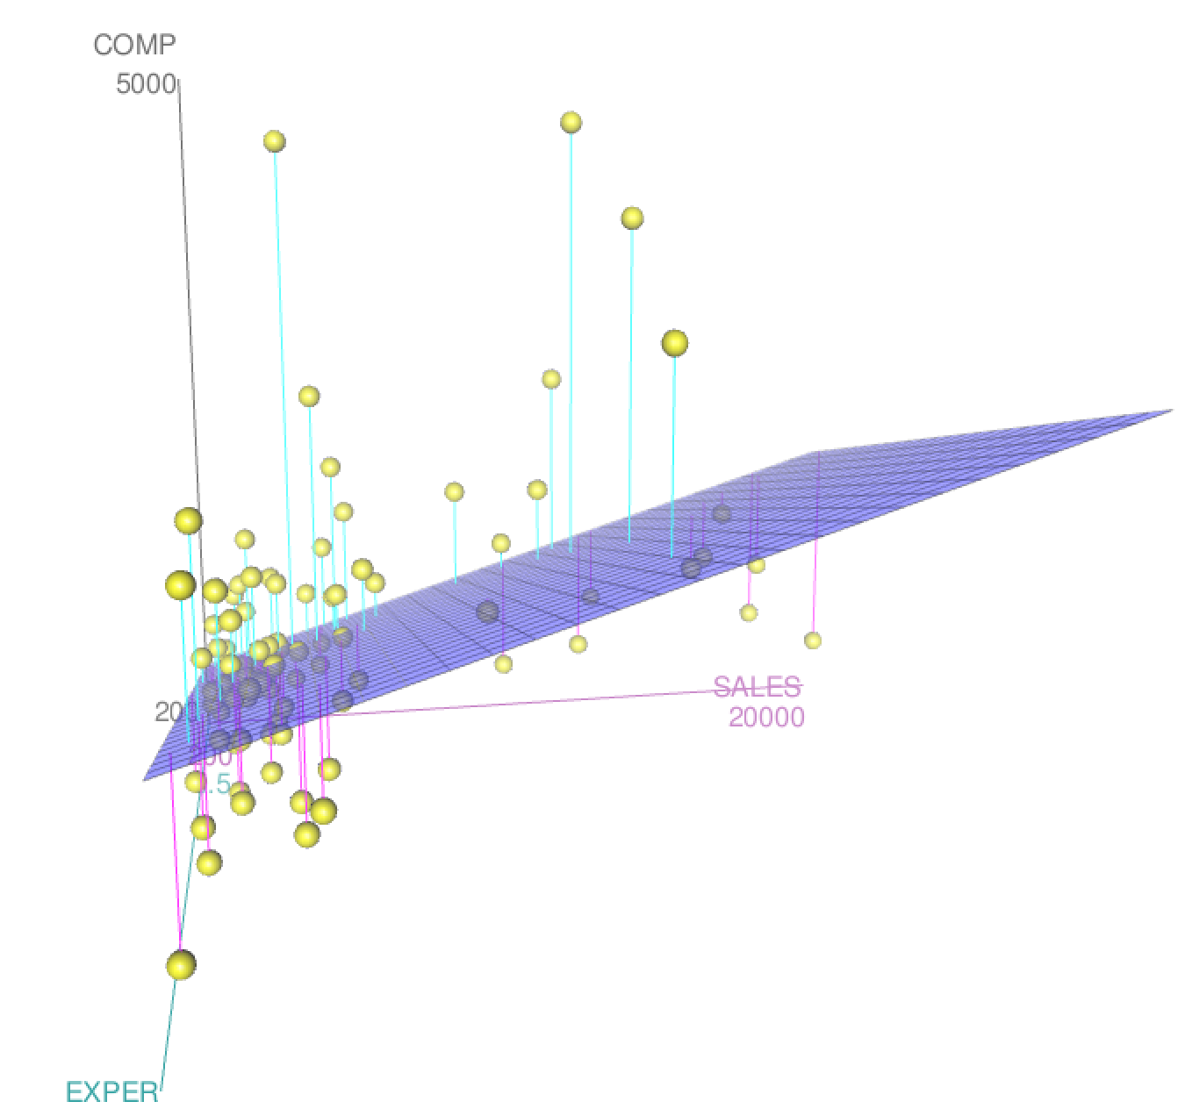

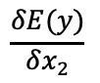
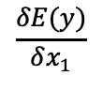
Effect of Variables
Change in the expected value of COMP
$$\frac{δE(y)}{δx_{2}}$$
Produced by a change in the variable EXPER
Change in the expected value of COMP
$$\frac{δE(y)}{δx_{1}}$$
Produced by a change in the variable SALES

Slide 13
Could There Be an Interaction?
Question: The effect of experience on CEO compensation depends on the sales of the company?
Question: The effect of sales of the company on CEO compensation depends on the experience of the CEO?

Slide 14
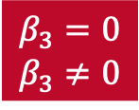

Model With Interaction Term
Population Model
COMP = β₀ + β₁SALES + β₂EXPER+ β₃SALES*EXPER+ ε
Hypothesis Test
$$β_{3}=0$$
$$β_{3}≠0$$

Slide 15
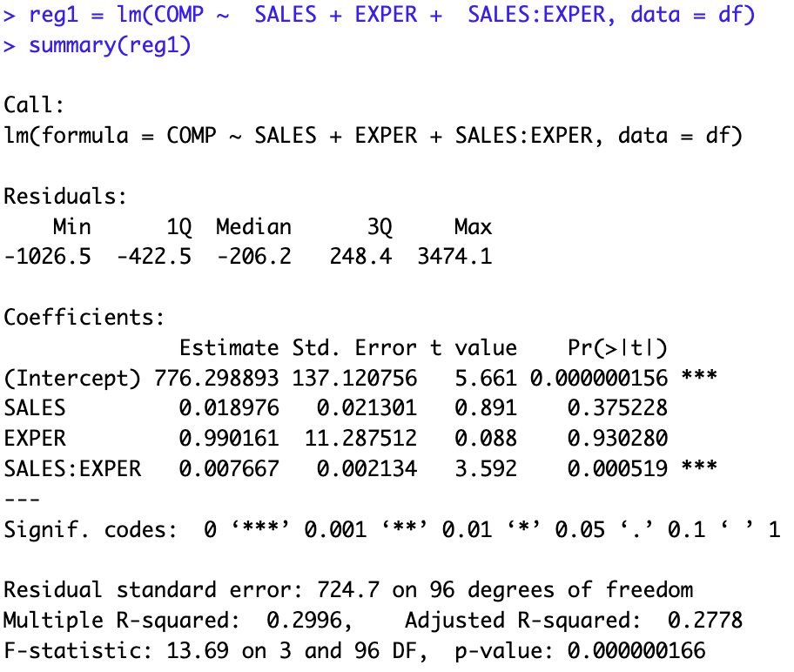
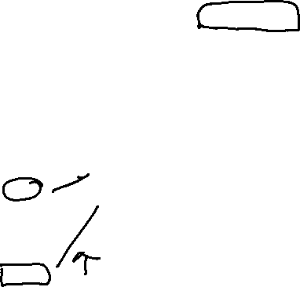
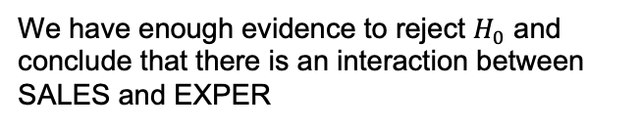
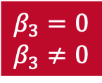
Estimates
Original variables not significant. We would still keep SALES and EXPER in the model even if they are insignificant IF the interaction is significant
Hypothesis Test
$$β_{3}=0$$
$$β_{3}≠0$$
We have enough evidence to reject $H_{0}$ and conclude that there is an interaction between SALES and EXPER
COMP = β₀ + β₁SALES + β₂EXPER+ β₃SALES*EXPER+ ε

Slide 16
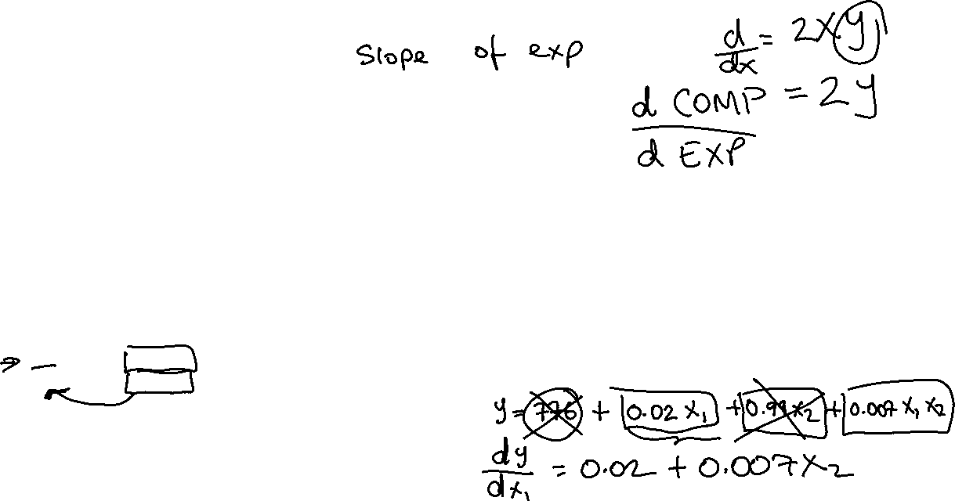
Estimates
Original variables not significant. We would still keep SALES and EXPER in the model even if they are insignificant IF the interaction is significant
Hypothesis Test
$$β_{3}=0$$
$$β_{3}≠0$$
We have enough evidence to reject $H_{0}$ and conclude that there is an interaction between SALES and EXPER
COMP = β₀ + β₁SALES + β₂EXPER+ β₃SALES*EXPER+ ε

Slide 17
Estimates Interpretation
Effect of Variable Experience: As CEO experience increases by 1 year, we estimate the COMP to change by: 0.990161 + 0.007667 SALES
For example, if SALES = 100 then: As CEO experience increases by 1 year, we estimate the COMP to change by: 0.990161 + 0.007667(100) or $1,756.86 holding other variables constant
COMP = β₀ + β₁SALES + β₂EXPER+ β₃SALES*EXPER+ ε

Slide 18
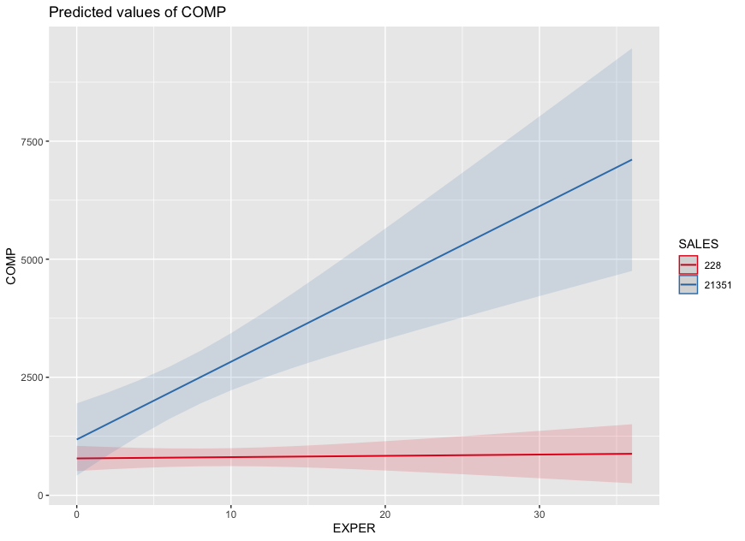
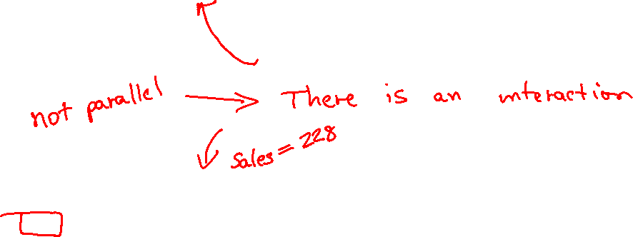
Interaction Plot
As CEO experience increases by 1 year, we estimate the COMP to change by: 0.990161 + 0.007667(21351) or $164,688.3 holding other variables constant
As CEO experience increases by 1 year, we estimate the COMP to change by: 0.990161 + 0.007667(228) or $2,738.23 holding other variables constant

Slide 19
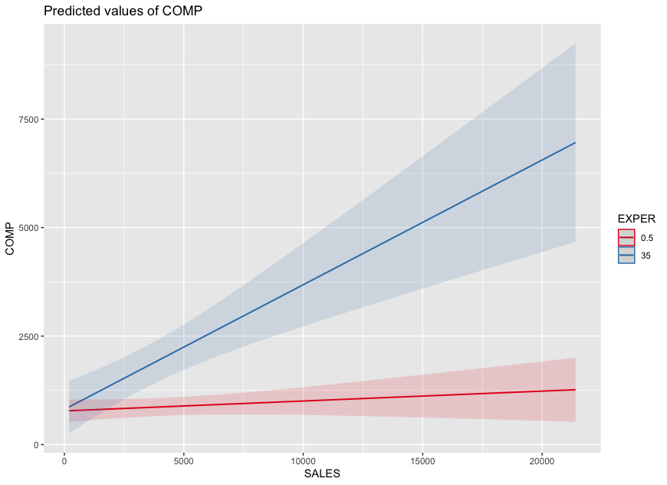
Interaction Plot
As sales of the company increases by 1 Million, we estimate the COMP to change by: 0.018976 + 0.007667(35) or $287.321 holding other variables constant
As sales of the company increases by 1 Million, we estimate the COMP to change by: 0.018976 + 0.007667(0.5) or $22.81 holding other variables constant

